Slide 1
Embedded Network SoC Systems

Slide 2
Lecturer
Prof. Chi-Sheng Shih 施吉昇
  Office Hour:
    Friday: 11:00AM ~ 12:00PM
    Office: Rm 523 CSIE
  Email: cshih@csie.ntu.edu.tw
Course Website: http://rtlab.csie.ntu.edu.tw/course/NetworkedSoCSystems
TAs: 連政閩 陳奕安

Slide 3
Schedules
Lectures:
  Thursday: 10:10 ~ 12:00PM
Lab Sessions:
  Session 01: Monday 2:20PM ~ 4:10PM
  Session 02: Wednesday 2:20PM ~ 4:10PM

Slide 4
Lab Session
In the lab, you will learn how to program an embedded system so that
  the system can receive the data from outside world,
  the system can control certain devices,
  the system can change its power configuration adaptively, and
  the system can communicate with other systems.

Slide 5
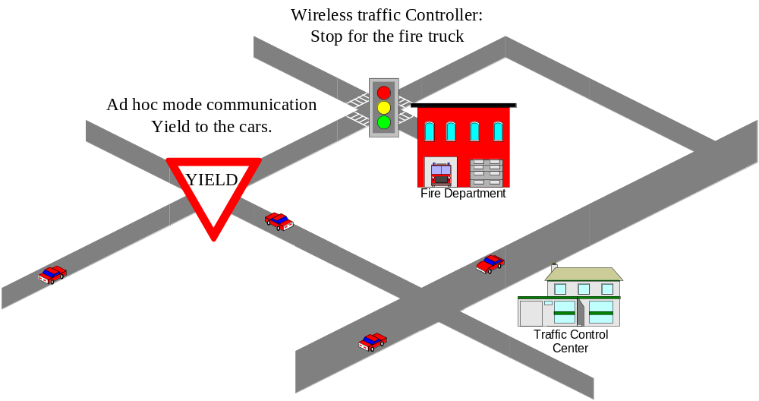
Intelligent Traffic Control

Slide 6
Grade
Exams:
  Mid-term: 30%
  Final: 30%
Labs: 40%
  You should participate every lab and know how it can be done.
  Lab materials are included for mid-term and final exams.

Slide 7
Introduction
Unit 1

Slide 8
Course Outline
Introduction for Embedded Systems
Real-Time Systems
Embedded Programming
Power Management and Low Power Design of a Networked SoC System
Networks for Embedded Systems
WLAN and WPAN
Mobile Ad-Hoc Networks
Security in Wireless Network Systems

Slide 9
Introduction for Embedded Systems

Slide 10
Products with Embedded Systems ?
Of 4 billions microprocessors/microcontrollers sold (2002), 95% are for embedded products:
  VCRs, DVD players
  Cell phone
  Microwave
  Washer
  Camera
  Cars (antilock brake system, air-bag, gas injection, electricity distribution..)
  Printers, copiers
  ………

Slide 11
Why are Embedded Systems Different
Dedicated to a specific task or tasks
Rich variety of microprocessors ( over 300 types )
Designs are cost-sensitive
Have real-time performance constraints
Used with Real-Time Operating Systems (RTOS)
Software failure can be life-threatening
May have constraints on power consumption
Operate over a wide-range of environmental conditions
Fewer system resources then a desktop system
All code might be stored in ROM
Require specialized design tools
May have on-chip debugging resources

Slide 12
What is an Embedded System?
Typical textbook definition:
  “A computer that is a component in a larger system, and is not visible as a computer to a user of that system.”
But - An embedded system may:
  Look and function like a traditional computer,
  Have a typical computer User Interface, or
  Not contain a traditional CPU at all!

Slide 13
“Embedded System” Defined
Our (better) definition:
  “A programmable component or subsystem providing some intelligence functions to the system of which it is a part.”
This can include:
  Any device, or collection of devices, that contain one or more dedicated computers, microprocessors, or microcontrollers.
  Microprocessor chips
  Programmable logic elements (FPGA, ASIC etc.)
  Device(s) may be local - Printer, automobile, etc.
  Devices may be distributed - Aircraft, ship, internet appliance.
  A PC or workstation may be an embedded system.
Key point:
  Embedded computing devices have rigidly defined operational bounds.
  Not general purpose computers (PC, Unix workstation).

Slide 14
Questions for consideration
Is a PDA an embedded system?
Is a cell phone an embedded system?
What about a Garmin GPS/PDA?
Is a PC inside of an industrial robot an embedded system?

Slide 15
Characteristics of Embedded Systems
In general, there is no architectural link to standard platforms
  PC ( Win9X, NT, XP, Linux), MAC, HP, Sun are considered the standard platforms.
  Almost every embedded design ( hardware and software ) is unique
  The hardware and software are highly integrated and interdependent, such as ASICs, microcontrollers
Typically, embedded systems have moderate to severe real-time constraints
  Real-time means system must be able to respond to the outside world.
Embedded systems may or may not have Operating System (OS) services available
  No printf() for debugging when there is no terminal!
Tolerance for bugs is 1000X ( or more ) lower in embedded systems then in desktop computers.
  May be life-threatening consequences if system fails
  Often engineered for the highest possible performance at the lowest cost
  Performance may not be an important consideration
They are most likely to have power constraints.

Slide 16
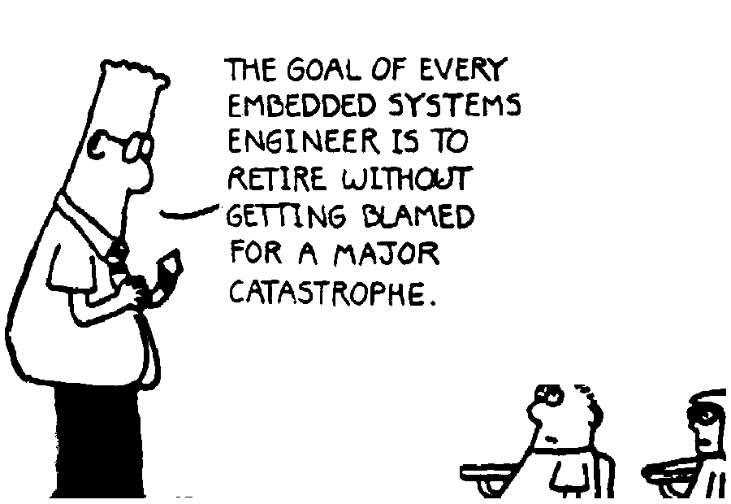

Slide 17
Let’s Define Some Terms
Microprocessor
  An integrated circuit which forms the central processing unit for a computer or embedded controller, but requires additional support circuitry to function
  MC68000, 80486, Pentium, K6, MicroChip PIC, etc.
Microcontroller
  A microprocessor plus additional peripheral support devices integrated into a single package
  Peripheral support devices may include:
    Serial ports ( COM ), Parallel ( Ports ), Ethernet ports, A/D & D/A
    Interval timers, watchdog timers, event counter/timers, real time clock ( RTC )
    Other local processors ( DSP, numeric coprocessor, peripheral controller )
  BrainStem on PPRK is a microcontroller

Slide 18
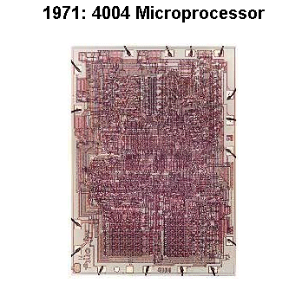


Where it all started!
Intel founders Bob Noyce
& Gordon Moore
Microprocesser
Inventor Ted Hoff
  See: http://www.intel.com/intel/museum/25anniv/index.htm

Slide 19
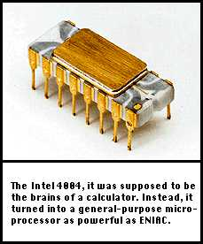
What Made E.S. Possible ?
Small and Cheap
1971: Intel 4004, first microprocessor (4bits), initially for a calculator.
1981: IBM chooses Intel 8088 for the first PC.
Microprocessors get so cheap that microprocessor-based control systems become the rule.
Only limit: processing time.

Slide 20
Microprocessor and Microcontroller
A Microprocessor-Based Embedded System
A Microcontroller-Based Embedded System
Data
Storage
Program
Program
Data
Memory
Memory
Storage
I/O
I/O
Microprocessor
I/O
Microprocessor
Core
I/O
Real-time
I/O
Clock
Real-time
I/O
Clock
To outside world
To outside world

Slide 21
A “Typical” Embedded System
Minimally Requirement for an Embedded System
NMI
Address Bus
Data Bus
Other
Peripheral
Devices
Microprocessor
Status Bus
Glue Logic and
Address Decode
Clock Generation
and Distribution
To Outside World
Random Access
Memory - RAM
I/O Interface
( D/A, A/D, Digital )
Read Only
Memory - ROM
( FLASH )
Communications
Watchdog Timer
Real Time Clock
To outside world
To other devices
To host Computer
To User I/F

Slide 22
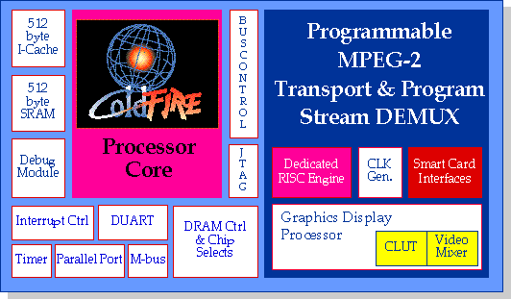
Recent developments
Moore’s Law: the complexity of integrated circuits will double every 18 months
Process technology able to put more and more functionality on the same chip as the cpu
Buzz Word: System on a Chip (SOC), or System on Silicon
ColdFIRE is designed to keep the 68K family alive!

Slide 23
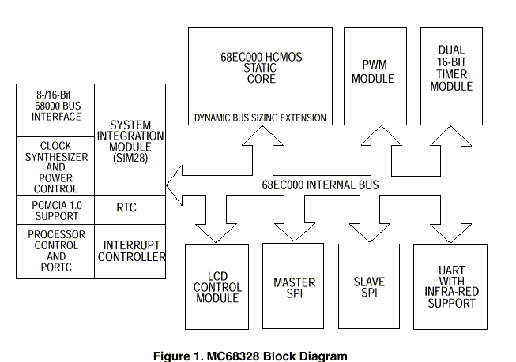
One Example: PalmPilot
Motorola’s Dragonball Processor
The MC68328 was chosen for Palm Pilot because it is highly integrated

Slide 24
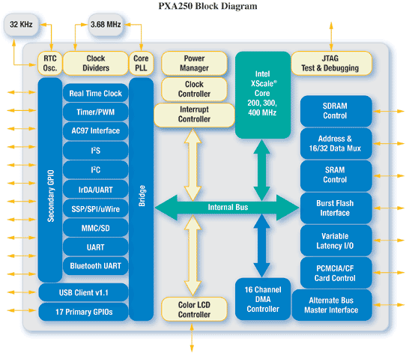
Another Example: Intel PXA 250

Slide 25
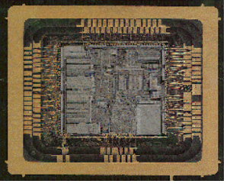
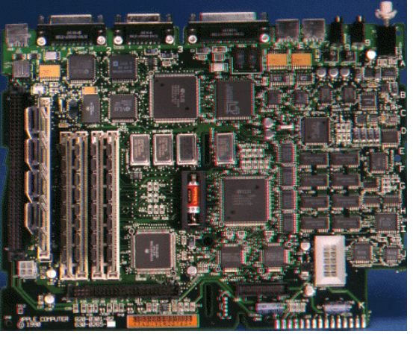
Trends in embedded systems
Processor plus ASIC
Embedded system on a board
System-on-Chip
0.35 u process technology > 10⁶ gates
0.18 u process technology > 4x10⁶ gates
0.12 u process technology > 9x10⁶ gates
0.08 u process technology > 20.3x10⁶ gates
20 million gates = 300, 68K microprocessors on one chip

Slide 26
What drives to higher integration?
You tell me!

Slide 27
Let’s Define Some Terms - 2
Target system
  The embedded system under development
Host computer
  The standard platform being used to develop the software and link to the target system for debugging
Cross-development
  Using host-based tools to create a code image that will execute on a different instruction set architecture
  Example:
    Write a C program on your PC
    Compile it to run on a PowerPC 603 using a Cross-compiler
    Create a runtime image for execution in the target system

Slide 28
The embedded lifecycle
The Project
Pre-Prototype
Post-Prototype
H/W Design
Proto
Debug
Specification
RTOS
Integration
Sys. Test
Mfg.
S/W Design
The Integration “Loop”
Yes
New Test?
Yes
Pass
Test?
No
Start
Run Test
Debug
Re-design physical h/w and/or s/w
Stop
No

Slide 29
Let’s Define Some Terms - 3
Time sensitive
  If a task or operation does not complete in the specified amount of time, the embedded device will perform below design requirements
  Example: A laser printer prints 8 pagers per minute instead of 10 ppm ( HP trumps Lexmark once again! )
  Device continues to function.
Time critical
  If a task or operation does not complete in the specified amount of time, the embedded device will fail.
  Example: Flight control system on a fly-by-wire aircraft.
  Device will not operate.

Slide 30
Real-Time Systems

Slide 31
Review “Real-Time”
“Batch Mode”
  Program runs independent of outside world.
  Results written to file or output device.
  Example: Compiler
“On-Line Mode”
  User may interact with program.
  No time constraints involved.
  Example: Spreadsheet
“Real-Time Mode”
  Program interacts strongly with environment.
  Time constraints imposed.
  Example: Video Game

Slide 32
Real-time Systems
A real-time system is one where the timing of a result is just as important as the result itself.
A correct answer produced too late is just as bad as an incorrect answer or no answer at all.
Timeliness is the single most important aspect of a real-time system.
“A real-time system is one in which the correctness of the computations not only depends upon the logical correctness of the computation but also upon the time in which the result is produced. If the timing constraints are not met, system failure is said to have occurred
Timing constraints can vary between different real-time systems. Therefore, systems can fall into one of three categories:
  Soft Real-time Systems
  Hard Real-time Systems
  Firm Real-time Systems
Note that literature rarely mentions firm systems.

Slide 33
Soft Real-time Systems
Timing requirements are defined by using an average response time. A single computation arriving late is not significant to the operation of the system, though many late arrivals might be.
Example: Airline reservation system - If a single computation is late, the system’s response time may lag. However, the only consequence would be a frustrated potential passenger.

Slide 34
Hard Real-time Systems
Timing requirements are vital!
  A response that’s late is incorrect and system failure results.
  Activities must be completed by a specified deadline, always.
  Deadlines can be a specific time, a time interval, or the arrival of an event.
  If a deadline is missed the task fails. This demands that the system has the ability to predict how long computations will take in advance.
Example: Pacemaker – If the system takes longer than expected to initiate treatment, patient death could result.

Slide 35
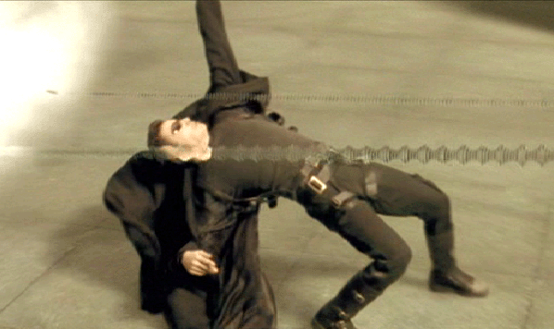
“Hard Real Time”
Courtesy Warner Brothers Studios

Slide 36
Firm Real-time Systems
Timing requirements are a combination of both hard and soft ones. Typically the computation will have a shorter soft requirement and a longer hard requirement.
Example: Ventilator – The system must ventilate a patient so many times within a given time period. But a few second delay in the initiation of the patient’s breath is allowed, but not more.

Slide 37
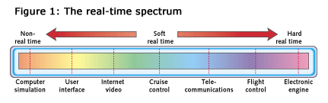
Real-time Systems
The distinction between systems can obviously become fuzzy.
  At one end of the software spectrum are non-real-time systems where all deadlines can be missed.
  At the other end are hard real-time systems where every deadline must be met.

Slide 38
Embedded Programming

Slide 39
Why Study Embedded System Design?
Hardware/Software Connection
  No OS layer to insulate application from HW
More Constraints
  Slower µP, less memory, no user interface
  Timing Constraints
Different Tools
  Cross compilers
  Hardware debuggers
More Tricky to Specify

Slide 40
I/O of Embedded Systems
Application dependent: switches, sensors, hexadecimal keyboard, LCD, basic keypads, communication cards, LEDs
Rarely:
  Monitor, hard-drive, secondary storage, mouse, keyboard, printer, …

Slide 41
OK, so what’s different about embedded?
C or C++ Compiler compiles into the instruction set of the Target microprocessor
  Code will not run natively on the host computer
    Can be run in an Instruction Set Simulator (ISS)
Many host O/S-dependent include files must be created especially for the target system
  printf(), cout(), malloc(), etc.
O/S services must be hand crafted for the hardware
  Called the Board Support Package (BSP) or BIOS
    printf(), fopen(), fclose(), malloc(), microkernel functions
    Hardware initialization
Code location changes with target
Code image is created to be loaded in ROM
Code may be relocated to RAM
Hardware is memory-mapped
Notes:
Memory mapped I/O - The use of the same instructions and bus to communicate with both main memory and input/output devices. This is in contrast to processors that have a separate I/O bus and special instructions to access it.
The I/O devices are addressed at certain reserved address ranges on the main memory bus. These addresses cannot therefore be used for RAM. Motorola and Mostec architectures, among others, use memory mapped I/O.
Video cards and other cards with on-board memory might be accessed in this way though the term applies not just to devices containing memory but to any device connected to the memory bus. Accessing the devices usually consists of reading and writing certain built-in registers though sometimes the mere presence of a particular address can trigger the device.

Slide 42
Code can also be downloaded
Many embedded systems contain only enough code in ROM to load the actual code image from another source
  Called a Boot Loader
  Similar to the program running on the 5206eLITE evaluation board
Satellites use this method
  Can reprogram the ROM when the satellite is past Saturn
Method used in PC’s
  BIOS ROMs contain enough code to load the operating system from disk
Convenient way to initialize the hardware so that it is ready to accept the application software

Slide 43

Embedded software development process
Source
Listing
Source
Listing
Create User
Library
(optional)
Librarian
C or C++
Source File
C or C++
Compiler
Assembly
Source File
Assembler
Relocatable
Object
Module
User
Library
Include
Files
Library
Directory
Listing
Linker
Command
File
Device
Programmer
Absolute
Object
Module
Linker
Relocatable
Object
Module
Target
Development
System
Link Map

Slide 44
Summary
We have discussed
  What’s an embedded systems?
  Why are embedded systems different?
  What’re real-time systems?
  Why are embedded programming different?
Next week, you will do your first lab to program your embedded system.

Slide 45
Power Management and Low Power Design of a Networked SoC System

Slide 46
Power Management & Low Power Design
Networked SoC System
  Mobile device
  Networked portable device
  Battery operated device
Low Power Design
  Low power hardware design
    Low power Networked SoC
    Low power uP and DSP
    Low power circuit and h/w platform
  Low power software design
    Low power OS
    Low power network protocols
Power Management
  Require lower layers support

Slide 47
Transistors on a microprocessor
1000000000
100000000
P-IV
P-III
10000000
486
P-II
1000000
P-I
386
286
100000
8086
Transistors
8008
8080
10000
Moore’s Law
1000
4004
100
10
1
1968
1970
1972
1974
1976
1978
1980
1982
1984
1986
1988
1990
1992
1994
1996
1998
2000

Slide 48
Transistors on a microprocessor trend
100
?
Pentium® II
Pentium® Pro
Pentium® 4
Pentium® III
10
Max Power (Watts)
Pentium®
Pentium®
w/MMX tech.
i486
i386
1
1.5μ
1μ
0.8μ
0.6μ
0.35μ
0.25μ
0.18μ
0.13μ

Slide 49
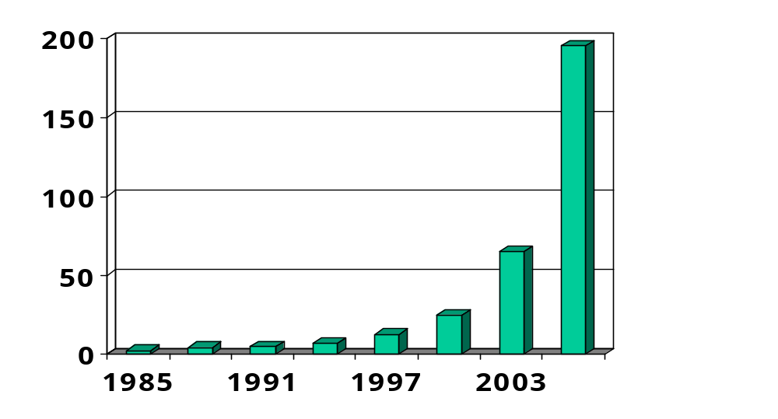
Chip power dissipation trend
Power (Watts)
Expected power consumption increase over the next 5 years is 300-400%

Slide 50
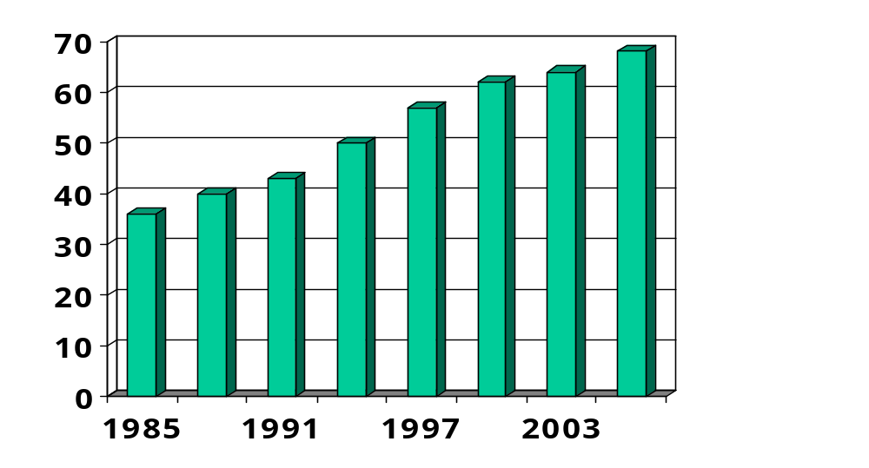
Battery energy density trend
Energy (KJ per lb)
Expected energy density increase over the next 5 years is 30-40%

Slide 51
Low power and power management
Power vs. energy
Power (Watt) is a rate of energy (Joule) consumption
  3 Watt × 12 sec. = 36 Joules
  Energy is the integral of power over time, P × T
A transistor dissipates energy on a state transition 0 to 1 or 1 to 0
More transistors ➔ more transitions ➔ more energy dissipation

Slide 52
Embedded Processor Support for Low Power Design
CMOS power components
  Switching power
    Dissipated by charging and discharging the gate output capacitance
      E_{t}=1/2 x C_{L} x Vdd²
  Short-circuit power
    Transitory conducting path from Vdd to Vss
  Leakage current
    The transistor networks do conduct a very small current when they are in their off state

Slide 53
Low power techniques?
Hardware to support power management capabilities
  Power modes
  Dynamical voltage scaling
  Adaptive caches
Software to be resource aware
  OS
  Applications
  Complier

Slide 54
CPU power modes
μP can be switched to operate at different modes
  Running: max power
  Idle: low power, state intact, quick recovery
  Sleep: ultra low power, state intact, takes longer to recover
  Deep sleep: minimum power, portions of state intact, takes even longer to recover

Slide 55
Dynamic voltage scaling hardware
V_{max}
Frequency
controlled
DC/DC
converter
μP
V
f_{max}
Frequency divider
f
Desired frequency
Speed reg.

Slide 56
Low Power Embedded OS Design
Scheduler could consider current workload and adjust CPU voltage/clock
EOS could provide power management API to application to vary CPU voltage
Disable unused h/w and drivers
Consider real-time application and its schedulability/power requirement
…

Slide 57
Power Control and Management of Network Protocols
Power Control
  To control the transmission/receiving power of a mobile device/a base station
Power Management
  To manage the level of power consumption(operational states) of a mobile devices/a base station

Slide 58
Low Power Network Protocol Design
Physical layer
  Low-power design at the hardware layer
    Variable clock speed CPU
    Flash memory
    Disk spin-down
Higher level layer concept
  Source of power consumption
    Communication
      Transmit
      Receive
      standby
    Computation
      CPU and memory is used in protocol stack processing
  Communication increasing make computation decreasing, and vice versus.

Slide 59
Low Power Network Protocol Design
Data link layer
  MAC layer
    Collisions and retransmission
    broadcast environment follow IEEE 802.11
    Rx-Tx mode switching
    distributed scheduling algorithm
  Link layer
    Automatic repeat request (ARQ) and forward error correction (FEC)
Network layer
  All nodes equally deplete their battery power

Slide 60
Low Power Network Protocol Design
OS layer
  Power-aware CPU scheduling
  Page allocation
App Layer
  Database access with power efficiency → mobile database system
  Video processing with power efficiency → mobile streaming system
  Software strategies for energy efficiency

Slide 61
Low Power Network Protocol Design
GSM Power Control
  Purpose
    minimize co-channel interference
    conserve power
  Power classes
    GSM 900 : 43dBm(20W), 39dBm(8W), 37dBm(5W), 33dBm(2W), 29dBm(0.8)
  Power level
    Increase/decrease in steps of 2dBm
  Threshold

Slide 62
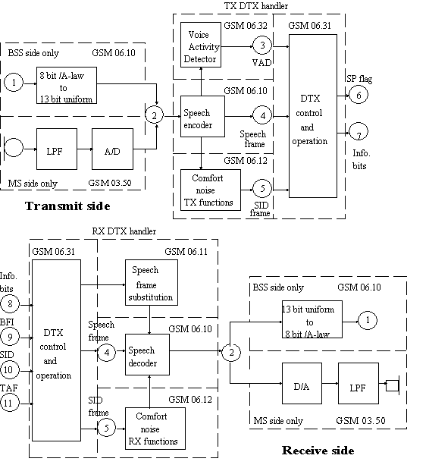
Low Power Network Protocol Design
GSM Power Management
  Discontinuous Transmission (DTX)
    40% voice active
    Save transmission power
  Discontinuous Reception (DRX)
    conserve power

Slide 63
Low Power Network Protocol Design
802.11 Power management
  Infrastructure network (unicast/multicast/broadcast)
  Ad hoc network (unicast/multicast/broadcast)
Beacon Interval
TIM:frame for 1&2
AP
TIM:frame for 1
TIM:frame for 1&2
Time
TIM:frame for 2
Station 1
Time
Station 2
Time
  Infrastructure network (unicast)

Slide 64
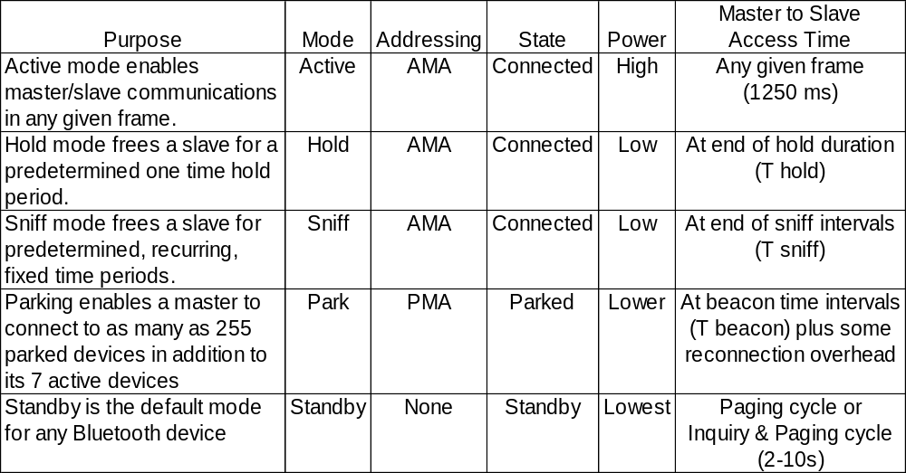
Low Power Network Protocol Design
Bluetooth Power management
Connected mode
standby mode
Source : XILINX web site

Slide 65
Networks for Embedded Systems

Slide 66
Wired Networks
SPI
I²C Bus
UART
RS-232c
USB
IrDA
CAN
Ethernet

Slide 67
Goal
To introduce the most popular wired network systems
  How does it work
  The difference among the different wired networks
  When/Where do we use them?
Notes:
我們將介紹這些網路系統如何運作，跟其他的系統有什麼不同
並且在什麼樣的環境去使用
我們會舉出一些電路圖的例子

Slide 68
Characteristics of Wired Networks
Data rate
Max Transmission Length
Working Environment
Number of connecting wires
Voltage
Serial / Parallel

Slide 69
Difference Among Wired Networks
Hardware evolution
  Data rate
  Transmission length
  Plug and play
  Easiness to develop
Environment factor
  Noise immunization
  Transmission length
Notes:
其實系統是有演進的，可能會有很多因素，如使用的需求(usb替換掉rs232)，或環竟的須要can
這些都會造成系統的演進。
而我們也可以透過瞭解系統的不同處，而知道這些系統演進的過程。

Slide 70
WLAN and WPAN

Slide 71
Classification of Wireless Networks (1)
Wireless WAN Technology
  IEEE 802.20
Wireless MAN Technology
  IEEE 802.16
  ESTI HiperMAN & HiperAccess
Wireless LAN Technology
  IEEE 802.11
  ESTI HiperLan
Notes:
在這個階段當中，我們介紹了無線網路相關的一些技術，包含廣域的無線網路 (WWAN)、都市的無線網路 (WMAN)、區域無線網路 (WLAN) 等等。其中的規格可以分為美規 (IEEE) 和歐規 (ESTI HiperLan) 的規格。

Slide 72
Classification of Wireless Networks (2)
WPAN – Wireless Personal Area Network
  IEEE 802.15.1: Bluetooth
  IEEE 802.15.3: UWB
  IEEE 802.15.4: Zigbee
  HomeRF WG: HomeRF
Notes:
在這個階段當中，我們介紹了無線網路相關的一些技術，包含廣域的無線網路 (WWAN)、都市的無線網路 (WMAN)、區域無線網路 (WLAN) 等等。其中的規格可以分為美規 (IEEE) 和歐規 (ESTI HiperLan) 的規格。

Slide 73
Wireless WAN
WWAN ( Wireless Wide Area Network)
IEEE 802.20: proposed
Refer to transmission range that can stride across many cities or countries.
Work in licensed frequency bands below 3.5GHz
Peak data rates per user in excess of 1 Mbps
Cover cell size commensurate with ubiquitous metropolitan-area networks

Slide 74
Wireless MAN
What’s Wireless Man ?
Introduction
IEEE 802.16
  IEEE 802.16 Standards
  Specification of IEEE 802.16
  Physical Layer
  Mac Layer
  Qos
ESTI
  HiperMan
  HiperAccess

Slide 75
Wireless LAN
Spread Spectrum Technology
  FHSS
  DSSS
  OFDM
IEEE 802.11
  Introduction
  IEEE 802.11/a/b/g
  IEEE 802.11e
  IEEE 802.11f
HiperLan
  Introduction
  HiperLan/1/2
  HiperLink

Slide 76
Bluetooth
What is Bluetooth?
  Standard
  Architecture
  Transmission access
  Connection state controlling
  Bit transfer
  Security
Application
The future

Slide 77
UWB
Introduction
What is UWB?
UWB types
Where does UWB serve?
The future

Slide 78
Zigbee
Introduction
Characteristic
What is Zigbee?
  Structure
  architecture
  Channel access
  Bit transfer
  Zigbee net type
Where does Zigbee serve?
What Zigbee can do?

Slide 79
HomeRF
Introduction
What is HomeRF ?
  Versions of HomeRF
  Architecture
    System Architecture
    Protocol Architecture
  Channel access
  Bit transfer
Where does HomeRF serve?
Sunset of HomeRF

Slide 80
Mobile Ad-Hoc Networks

Slide 81
Ad Hoc Network Characteristics
Instantly deployable and re-configurable (no fixed infrastructure)
Created to satisfy a temporary need
Node portability (eg sensors), mobility
Limited battery power
Multi-hopping ( to save power, overcome obstacles, enhance spatial spectrum reuse, etc.)

Slide 82

Why Ad Hoc Networks
Sometimes there is no infrastructure
  E.g., automated battlefield, disaster recovery
Sometimes not every station can hear every other station
  Data needs to be forwarded in a multi-hop manner

Slide 83
MANET Protocol Considerations
Simple, Reliable and Efficient
Distributed but lightweight in nature
Quickly adapting to changes in topology and traffic pattern
Protocol reaction to topology changes should result in minimal control overhead
Bandwidth efficient
Mobility Management involving user location management and Hand-off management

Slide 84
Categorization of MANET Routing Protocols
AD-HOC MOBILE ROUTING PROTOCOLS
TABLE DRIVEN / PROACTIVE
ON-DEMAND-DRIVEN / REACTIVE
HYBRID
WRP DSDV
CGSR STAR
AODV DSR
TORA ABR
ZRP

Slide 85
Research Field
Scalability
Quality of service
Client-server model shift
Security
Interoperation with the internet
Power control
Notes:
-Scalability
How large can an ad hoc network grow?
No one knows
It is safe to say that such a network cannot grow to the size of the Internet
Worse performance for route acquisition latency
-Quality of Service
Can bandwidth- or delay-constrained applications operate well?
Vulnerable to dynamic link quality variations between neighboring nodes
A route between two endpoints that initially meets the application’s Qos constrain may soon fail to meet them
-Client-server Model Shift
Security
What happens when a client cannot count on traditional methods to locate a suitable server?
When the network is itself dynamic, but its structure is no longer defined by techniques for collecting IP address into subnet
Existing techniques for static and automatic configuration break down almost completely
-Security
Is there a good way to protect against attacks from malicious ad hoc nodes?
Security for routing is always difficult, because of the difficulties of key distribution and refresh
Difficult to make good use of certificate revocation lists (CRLs) without infrastructure
Byzantine agreements
-Interoperation With the Internet
How can an ad hoc network take advantage of evanescent or dynamically changing points of connection to the Internet?
By the Internet “gateway”, a node has connectivity to the global Internet
Advertise itself as a default router
Other nodes can consider themselves connected to the default router by way of a multihop path
-Power Control
How can battery life be maximized?
Reducing power to the communication interface
Entering sleep mode
The advantages of reducing transmission power
Power savings at mobile nodes
Noise reduction at all other neighboring stations
Increased frequency re-use for the transmission channel

Slide 86
Security in Wireless Network Systems (I)

Slide 87
Outline
Introduction to Network Security
Confidentiality Using Conventional Encryption
Key Distribution
Public-Key Cryptography
Message Authentication
X.509 Certificates

Slide 88
Conventional Encryption
Conventional encryption
  symmetric encryption
  single-key encryption
Security depends on the secrecy of the key, not the secrecy of the algorithm

Slide 89
Key Distribution
Frequent key changes are desirable to limit the amount of data compromised if an attacker learns the key
Key distribution technique
  the means of delivering a key to two parties without allowing others to see the key

Slide 90
Public-Key Cryptology
1976 Diffie and Hellman: first public presentation of public-key concept
1978: RSA algorithm by Rivest, Shamir, and Adelman
The greatest revolution in the history of cryptography
Based on Mathematics, rather than Substitution and Permutation
using two keys, rather than only one key

Slide 91
Authentication Function
Authenticator: a value to be used to authenticate a message
Types of functions that produce an authenticator
  Message encryption
  Message authentication code (MAC)
  Hash function

Slide 92
X.509 Certificates
Directory is a database of information
  includes a mapping from user name to network address, and other information about the users
CCITT X.509
  defines a framework for the provision of authentication services by the X.500 directory to its users
Certificates are created by certification authority (CA)

Slide 93
Security in Wireless Network Systems (II)

Slide 94
Outline
Overview of Wireless LAN
Security Features of Wireless LAN
WEP and Its Weakness
802.11i

Slide 95
Security of 802.11 WLAN
Wired Equivalent Privacy (WEP)
  Link-level data (Not end-to-end security)
  RC4 static 40-bit key
Shared key authentication
  uses WEP key to authenticate users
MAC address filtering
  address list to restrict access

Slide 96
WEP
Authentication
  Only authorized persons gain access to the network
Confidentiality
  Only authorized persons can view the data
Integrity
  Has the data been tampered with?

Slide 97
Key Problems with WEP
(based on NIST-SP-800-48)
Security features are frequently not enabled
IVs are short (or even static)
Keys are short
Keys are shared
Keys cannot be updated automatically
RC4 has a weak key schedule: efficient attack to recover the key

Slide 98
Key Problems with WEP
(based on NIST-SP-800-48)
Packet integrity is poor: CRC32 is inadequate
No user authentication: only device is authenticated
Only simple SSID identification
Device authentication is simple shared-key challenge response
The client does not authenticate APs

Slide 99
802.11i Technology
User authentication
  802.1x + EAP (Extensible Authentication Protocol)
  Pre-Shared Key (PSK) for SOHO
Encryption
  AES-CCMP
Validation
  Message Integrity Check (MIC): Michael

